Slide 1
Network Traffic Anomaly Detection using Isolation Forest
Machine Learning-Based Suspicious Traffic Analysis & Power BI Visualization
Tools: Python (Pandas, Scikit-learn), Power BI, DAX
Blesson Biju
UMID – UMID27112571779
Dec 1st Batch

Slide 2
Problem Statement
Modern web servers generate large volumes of traffic logs.
Detecting suspicious behavior manually is inefficient.
Objective: Use Machine Learning to identify anomalous network sessions.
Validate results using data visualization.

Slide 3
Dataset Overview
1. Content:
282 network traffic sessions
19 features
2. Key features:
bytes_in
bytes_out
src_ip
country_code
session_duration
timestamp
3. HTTPS traffic (Port 443)
4. Labeled as Normal / Suspicious after ML detection

Slide 4
Anomaly Detection Model
Content:
1. Algorithm Used: Isolation Forest
2. Why Isolation Forest?
Effective for outlier detection
Works without labeled anomaly data
3. Features Used:
bytes_in
bytes_out
session_duration
4. Model Output:
anomaly_flag (-1 = Suspicious, 1 = Normal)

Slide 5
Model Output Summary
5% of sessions detected as anomalies
Suspicious sessions show:
Extremely high data transfer
Significant deviation from average traffic
Concentrated in few source IPs

Slide 6
Dashboard Visualization
Executive KPIs:
Total Sessions
Suspicious Sessions
Suspicious %
Anomaly Distribution (Donut Chart)
Average Bytes Comparison
Source IP Analysis
Time-Based Distribution

Slide 7
Key Insights from Visualization
Suspicious sessions contribute disproportionately high traffic volume.
Average bytes per suspicious session is significantly higher.
Suspicious traffic concentrated in specific IPs.
Time distribution shows moderate clustering.
Majority of suspicious traffic originates from US-based IPs.

Slide 8
Conclusion
Isolation Forest effectively detected high-volume anomalies.
Power BI helped validate behavioral deviations visually.
Approach can be extended with:
More features
Real-time monitoring
Advanced anomaly scoring

Slide 9
Tools & Technologies
Python (Pandas, NumPy, Scikit-learn)
Power BI & DAX
CSV-based analytics dataset
Jupyter Notebook

Slide 10
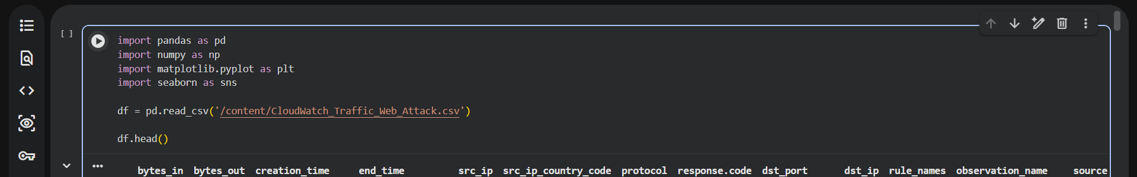
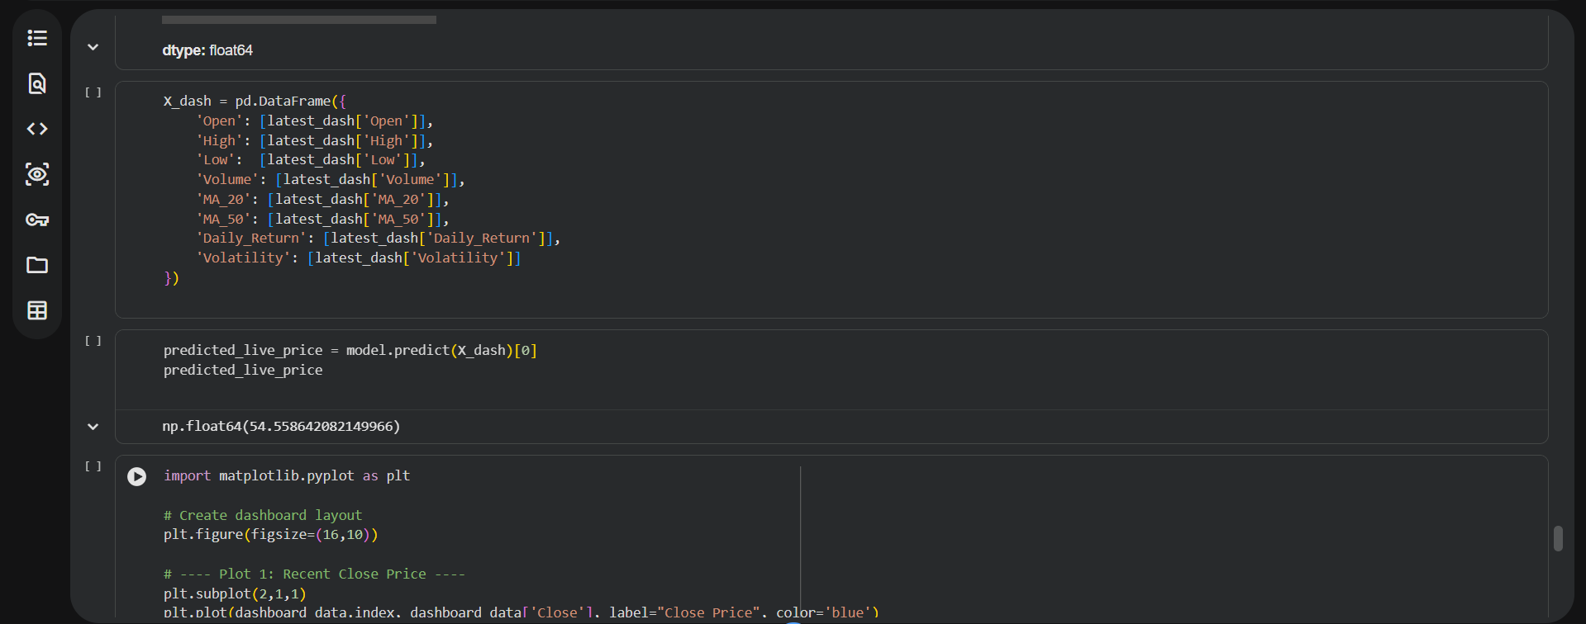

Slide 11
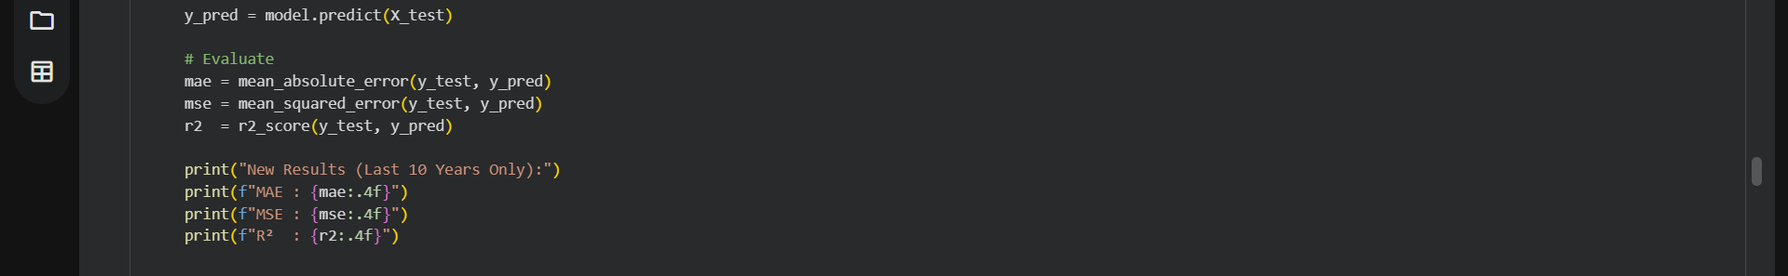
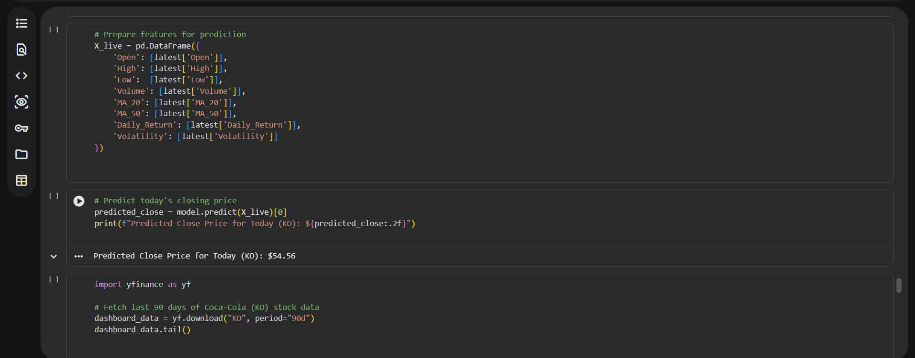

Slide 12
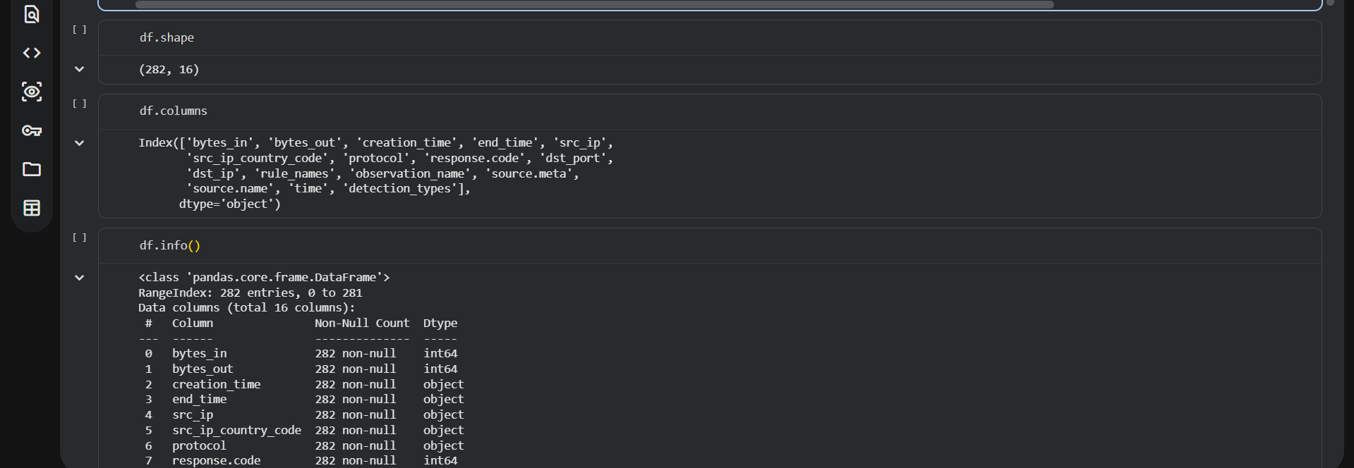
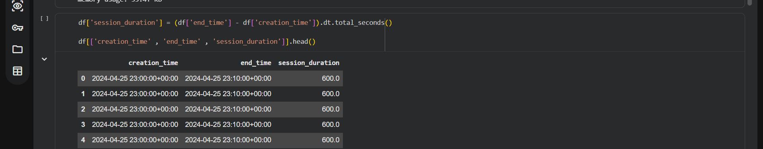
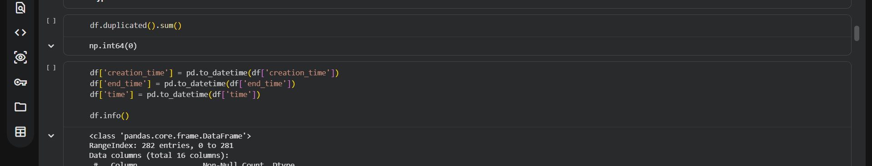

Slide 13
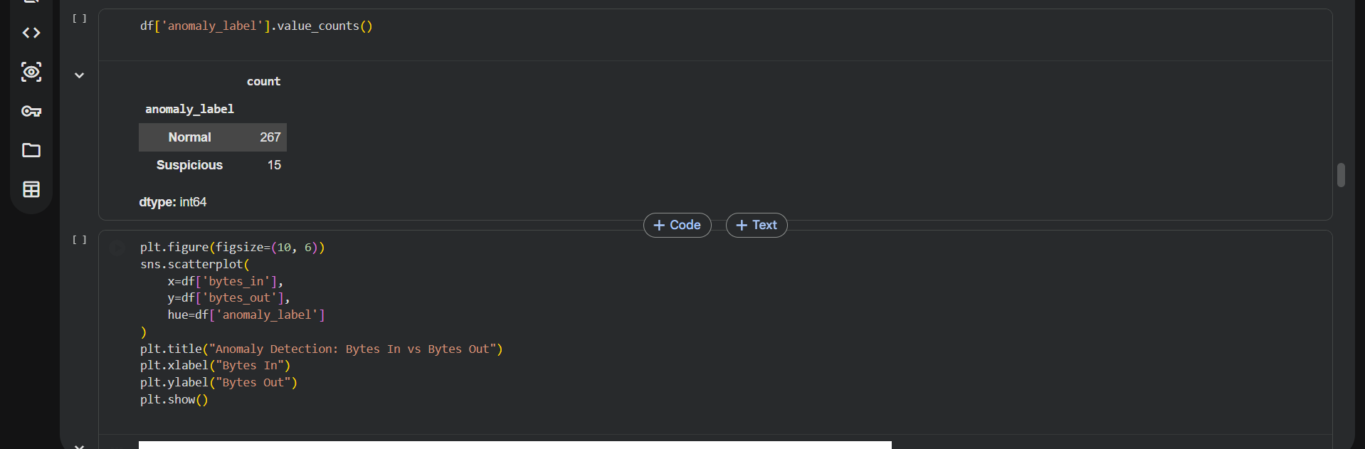
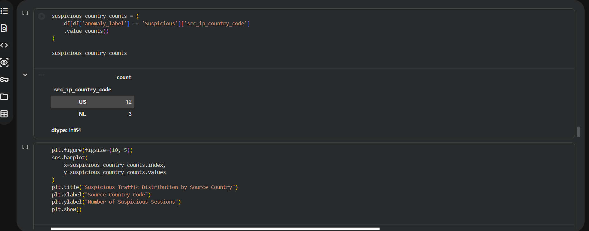

Slide 14
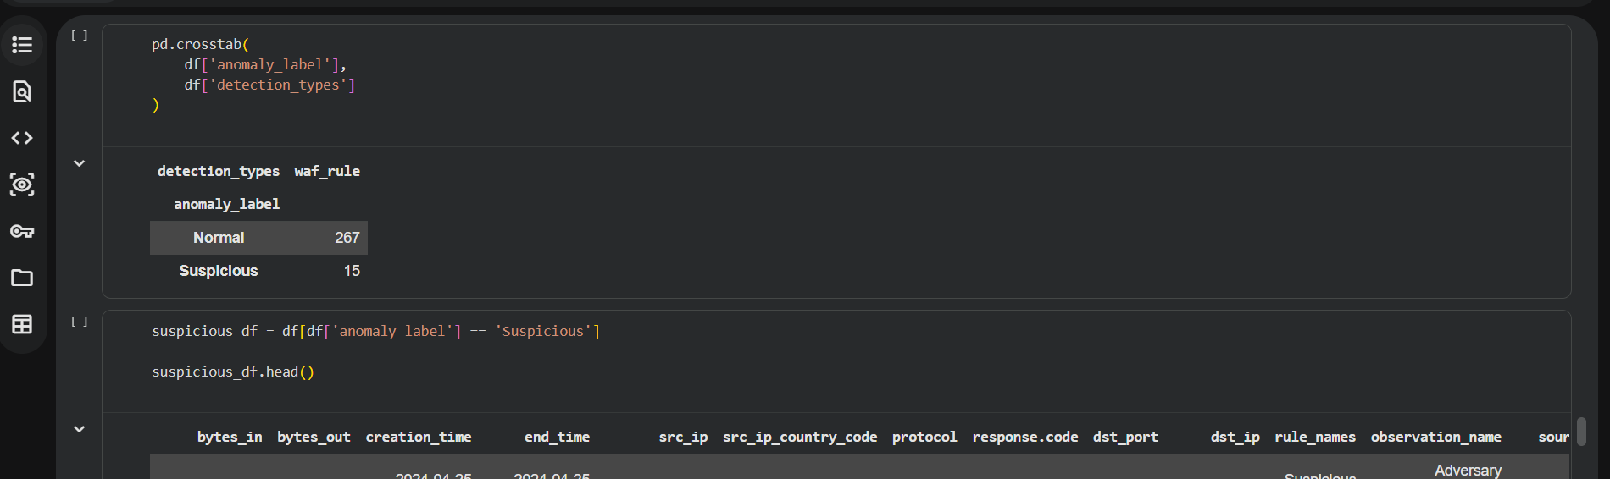
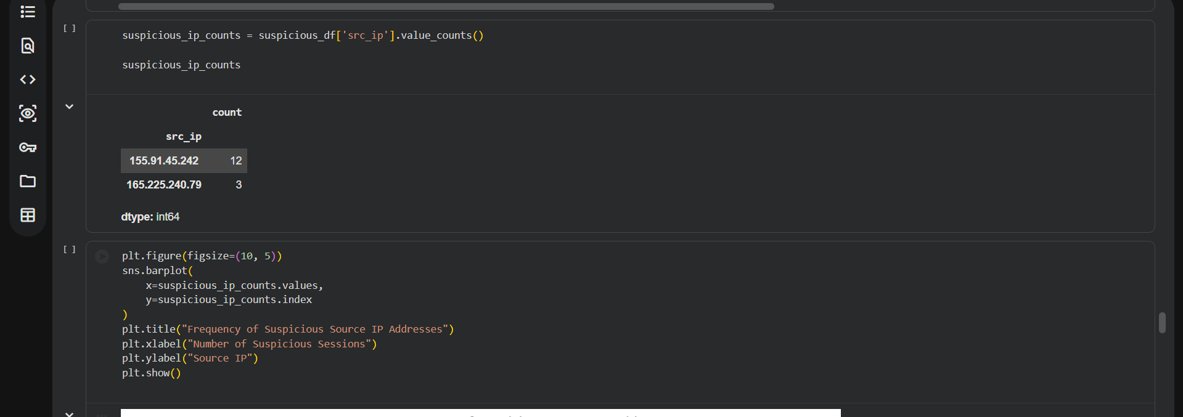

Slide 15
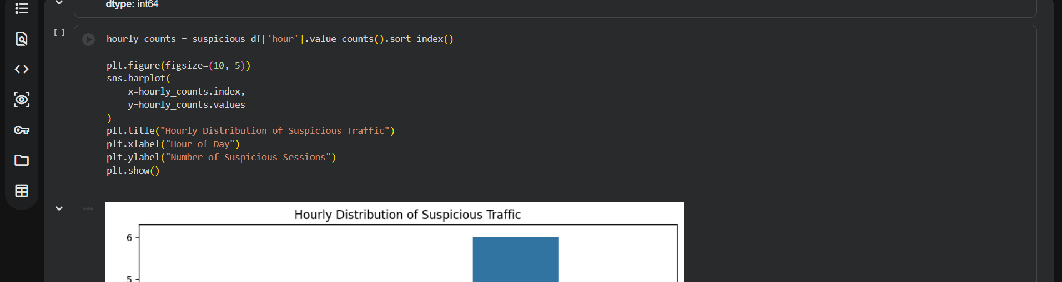
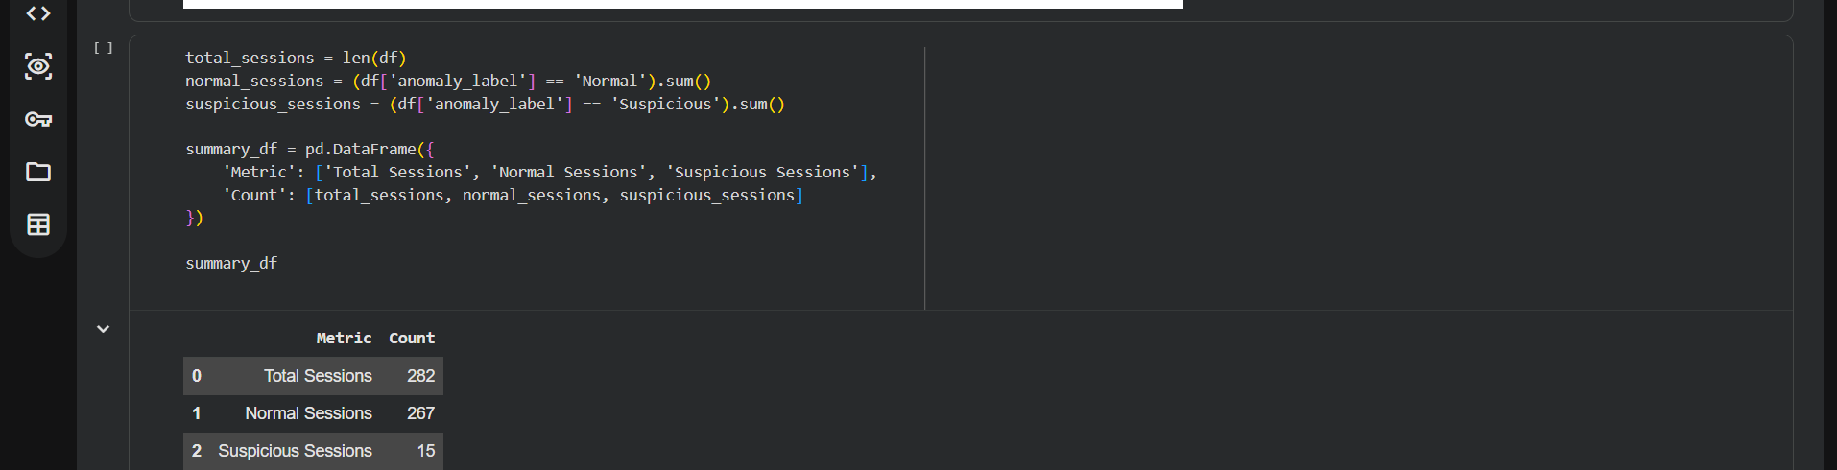

Slide 16
